Slide 1
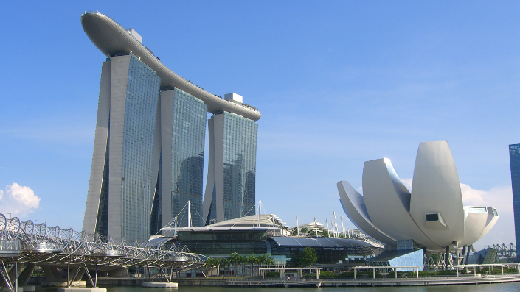
Briefing to HCMC Leaders
Data Strategy and Governance
29 August 2022
All rights reserved. The information contained in this document is confidential and may also be proprietary and trade secret. Without prior written approval from Tan Kim Leng no part of this document may be reproduced or transmitted in any form or by any means, including but not limited to electronic, mechanical, photocopying or recording or stored in any retrieval system of whatever nature. Use of any copyright notice does not imply unrestricted public access to any part of this document.
Copyrights ©Tan Kim Leng

Slide 2

Facilitator Profile
More than 30 years of consulting and training experience, business process management, process reengineering, quality management and digital transformation programmes
Worked with public sector agencies extensively to reform business processes and data management to help in redesigning processes to improve service delivery
Expertise in Electronic Government, Smart City, National ID Initiatives and Digital Government Transformation
Co-authored management book titled “Leading Change that Matters – Making Adoption a Reality” with Dr. Nancy Harkrider

Slide 3

Goals of Digital Transformation
Embrace innovation culture
Envision a different future
Exploit and explore
  Changing technology
  Competition
  Stakeholder needs and behaviour
Digital Transformation is about more than just technology

Slide 4
Service Excellence
Satisfied
customers
Customers
Service Delivery
Experience
Ensuring Quality
in Service Delivery
and Digital
Transformation
Input
Quality Process + Data
Output

Slide 5
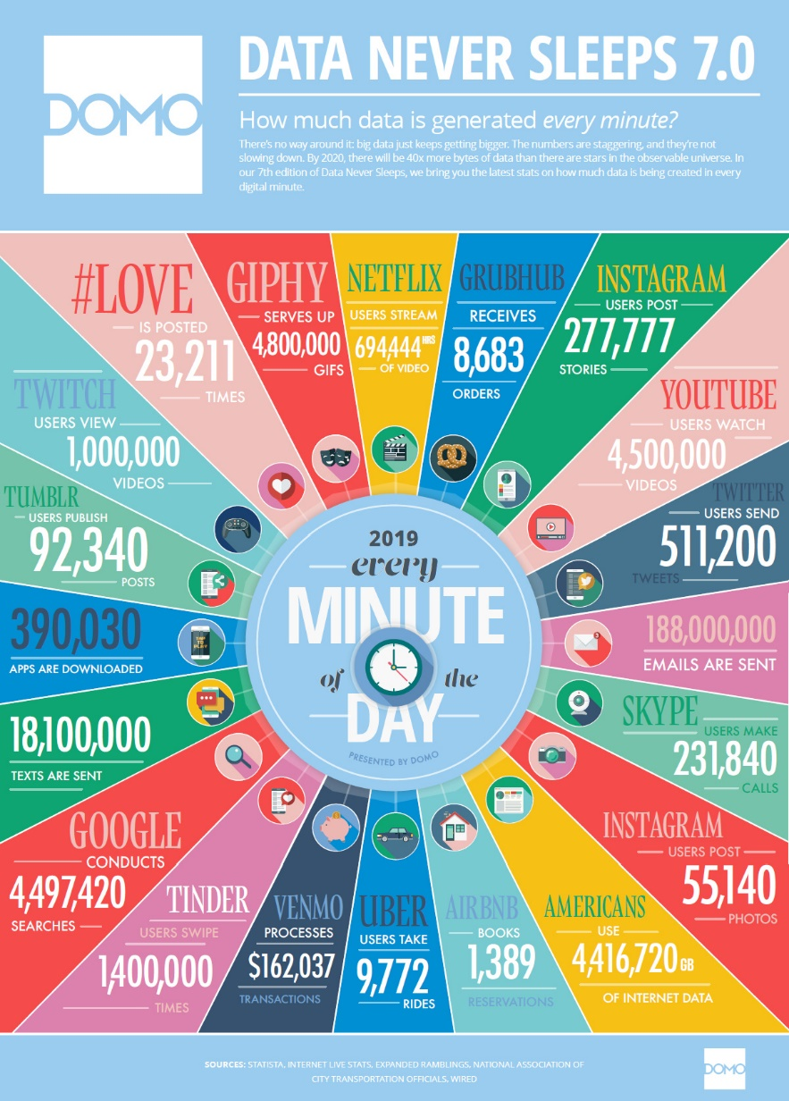
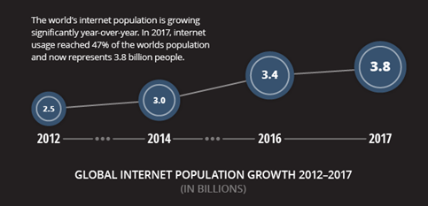
Explosion of Data
Source: Data Never Sleeps 7.0, Domo, Inc

Slide 6
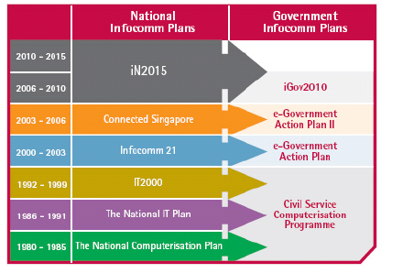
Singapore Digital Government Journey
Source: IDA
Notes:
6

Slide 7
Greater Efficiency for Public Services
- Three National Data Hubs
G2E
Public-Private
Cross Collaboration
Employees
Social
Development
G2B
G2G
Government
Economic Development
Employees
Services for Ease of doing Business
Legal Business Entities
2. Processes
(Outcome-focused
Simplicity & Automation)
Public Policies
Employees
Government
Common Data for Sharing
3. Data
(Control & Break Silo)
G2C
Legal Business Entities
Need for Data Standardization
Residents
（Citizens）
Governance
& Management
Managing People
National Data
Managing Land
National Data
Managing Establishment
National Data
1. People
（Stakeholder-Centric）
Identification
(Citizens)
(Property)
(Business)
Notes:
Goals & Strategy
= Efficient & Effective Government (Foundation)
= Common Data Standards (Break Silo)
= Demographics Data (Facilitate Aggregate data)
How to uniquely identify People, Property, Business?

Slide 8
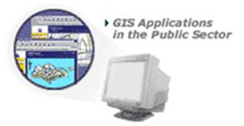
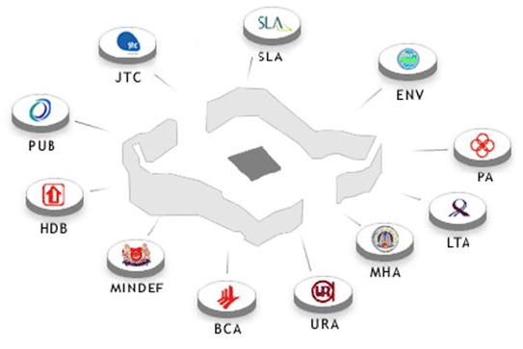
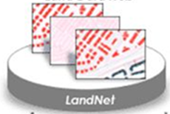
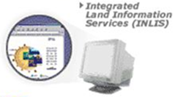
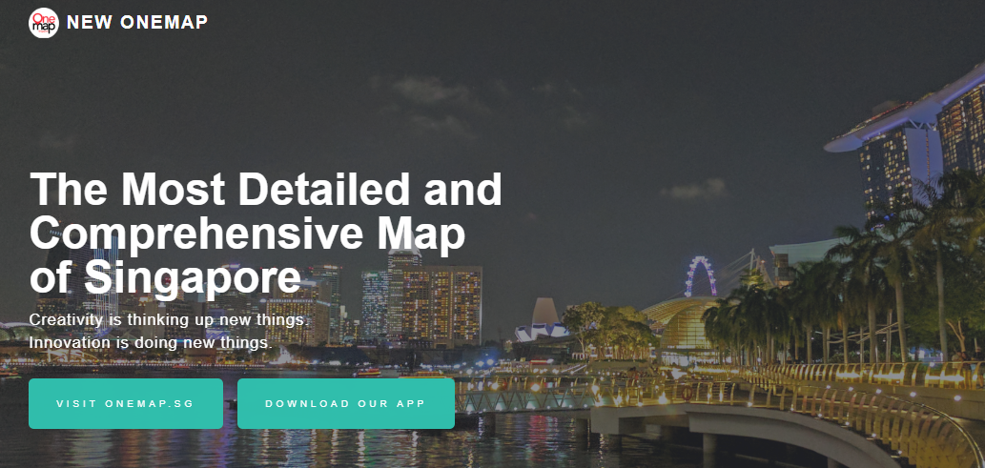
Land Data Sharing Evolution Over the Years
Geospace - GIS Data for Public Sector
1993
2007
2011
https://www.sla.gov.sg/inlis/#/
Integrated Land Information Services (INLIS) - For Public
https://www.sla.gov.sg/inlis/#/SMAP/CM/Detail
https://www.onemap.sg/home/
Benefits to Public Sector
Land Data Hub evolved into LandNet which in turn evolved into Geospace
Web-based online system
Improve timeliness in data sharing
Benefits to Private Sector
Make available maps for private sector
Private Sector (One Map) 2010

Slide 9
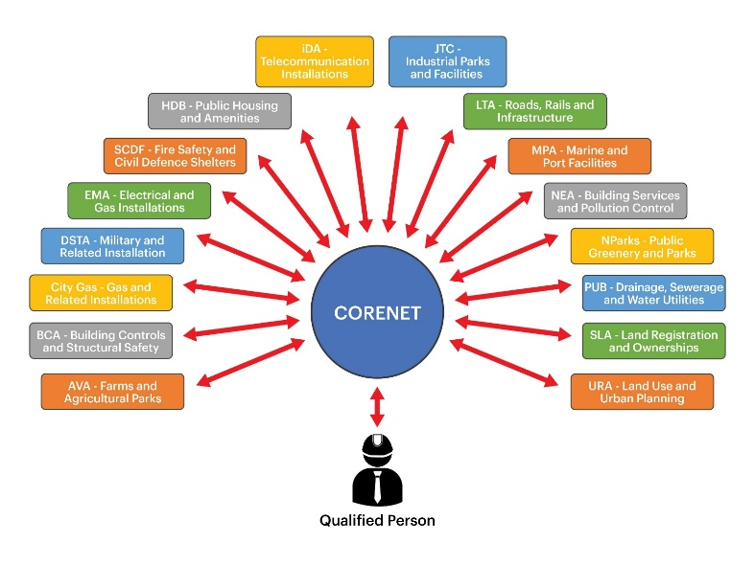
Construction & Real Estate Network
(CORENET)
Reengineer the business processes of the construction industry
Create shared construction project profile data and project personnel data
Coordinate building plans for submission and approval across 16 agencies, 209 application types, 845 different forms
System launched in 2001

Slide 10






Data.Gov.Sg - Government Data
Pillar for Smart Nation
First-stop portal to search and access publicly-available data
  Provide convenient access to publicly-available data published by the government
  Create value by catalysing application development
  Facilitate analysis and research
Most Viewed Datasets
  SLA Street Directory CBD Limit
  PA Headquarters
  SLA Street Directory Water Bodies
  SLA Street Directory Elevated MRT Network
  SLA Street Directory Cemetery
Launched in June 2011
  Over 8600 datasets from 60 government ministries and agencies.
MFA@SG
My Transport
Parking@sg
Police@sg

Slide 11

Key Concepts of Enterprise Data Management (EDM)
EDM is an organization’s ability to specify, incorporate, store and retrieve data for
  Internal processes and applications
  External service delivery and communications

Slide 12

Goals of EDM
Fundamental goal is to create and maintain assurance, confidence, and trust in all data assets
Governance
  Strategy, roles, organization, and policies
  Decision-making and monitoring
Management
  Offers a streamlined and standardized approach for organizations to manage and secure their data resources

Slide 13
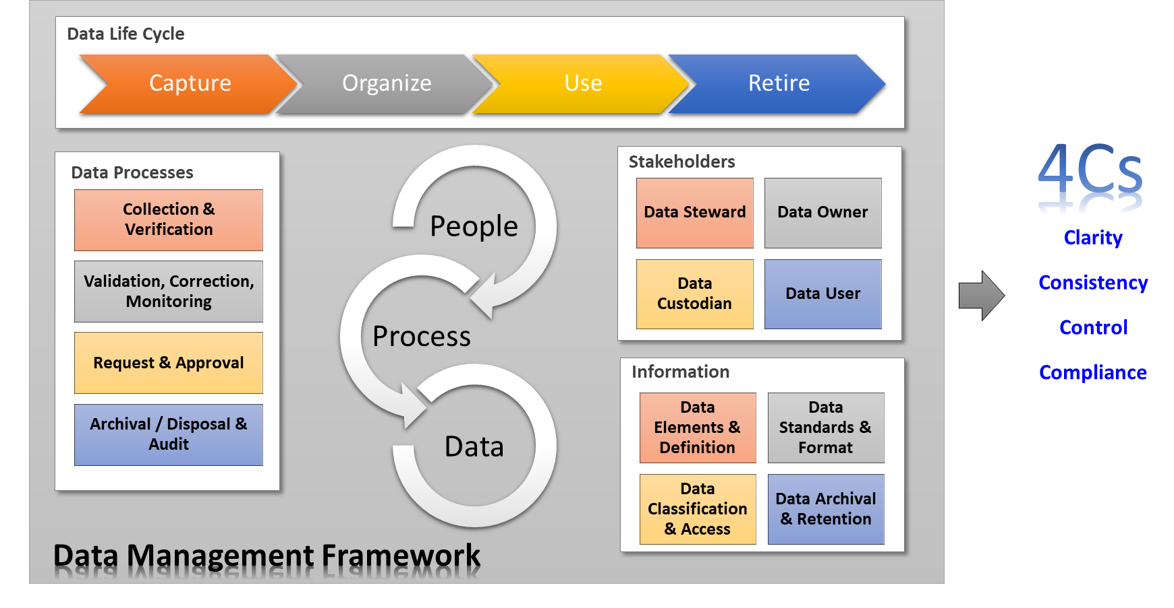
Data Management Framework

Slide 14
Key Principles of Data Management
Maximize benefits to the organization
  Data management decisions provide max benefits to the enterprise as a whole
Data is an asset
  Has value to the organization
Data is shared and accessible
  Necessary to perform duties, for users to perform their required functions
Common vocabulary and data definitions
  Consistency, understandable
Data trustee
  Accountable for data quality

Slide 15
Data Architecture – Data Sharing Framework
Establish what to be shared and value of own data
Policies considerations – confidentiality / PDPA
Technical considerations – preparing data for sharing
Operational consideration – ensure transparency and accountability, retention and disposal of data

Slide 16
Scope for Data Strategy and Governance
Provide facilitation support to the HCMC’s Data Governance Management (DGM) Team with proven EDM methodology and enablement practices
Establish a data architecture framework for the Whole-of-City (WOC) involved in the initiative

Slide 17
Focus of the Workshops
Workshop 1
  Vision and governance for WOC
  Enterprise Data Management Framework
  Data management policies
  Roles and responsibilities
Workshop 2
  Data architecture for data sharing
  Data quality and improvements
  Operationalisation of data integration and exchange
  Action plans and potential roadmap

Slide 18

Thank You!

